Slide 1
Predict, Prevent, Personalize Health AI at Northwell
Theodoros Zanos, Ph.D.
Associate Professor
Head, Division of Health AI
Head, Neural & Data Science Lab
Institute of Health System Science
Institute of Bioelectronic Medicine

Slide 2
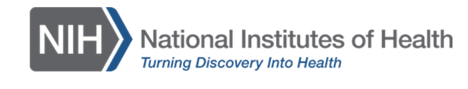
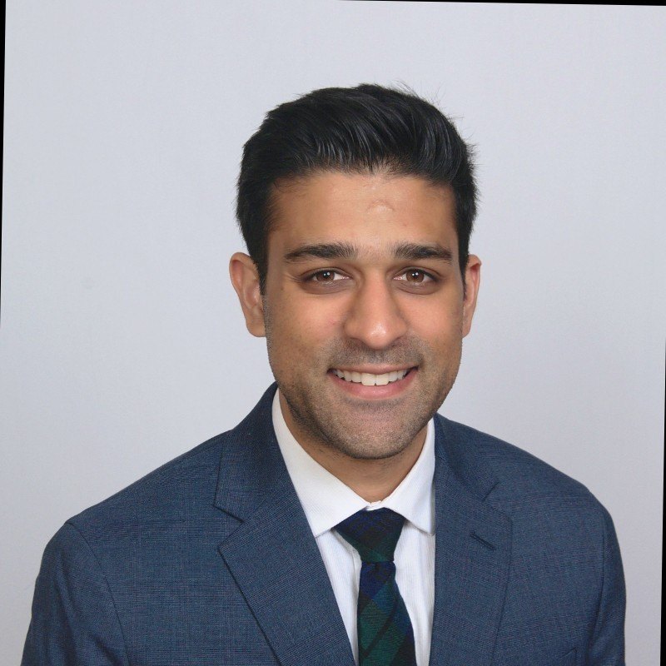

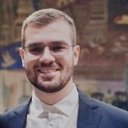


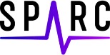
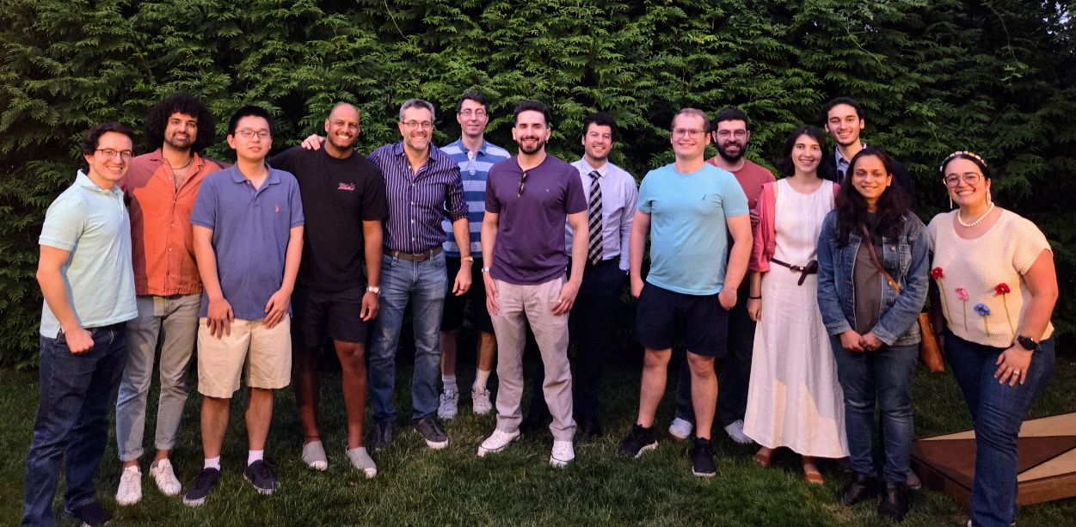

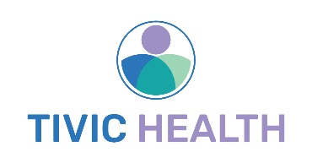
Division of Health AI Neural & Data Science Lab
Institute of Health System Science | Institute of Bioelectronic Medicine | Quantitative Intelligence
Members
Todd Levy, MS
Shubham Debnath, PhD
Michael Scheid, PhD
Lucas Cang
Nabil Ettehadi, PhD
Alejandro Quintero Villegas, MD
Philip (Arash) Mirian, MSDS, PT
Theofilos Kanavos, MD
Effrosyni Birbas, MD
Derek Hansen, PhD
Elly Konjkav
Soroush Arabshahi, PhD
Nick Tsaftaridis, MD
Panayiotis Christou, MS
Hardik Patel, DO
Diego Gonzalez Garcia-Torres
Viktor Toth, MS
Thanh Nguyen
Rohan Sen
Collaborators
Kevin Tracey, MD
Karina Davidson, PhD
Stavros Zanos, MD PhD
Jamie Hirsch, MD
Alex Makhnevic, MD
Liron Sinvani, MD
Mark Sands, MD
Paul Chung, MD
Rob Koppel, MD Barry Weinberger, MD
Stavros Mountantonakis, MD
Alisha Oropallo, MD
Matt Barish, MD
Marcovalerio Melis, MD
Stephan Bickel, MD PhD
Alex Spyropoulos, MD
Rebecca Schwartz, PhD
Fay Wright, RN PhD
DivHealthAI.com
Neuraldatascience.org
Notes:
I’d like to start by thanking all the division members, the true heroes carrying out all this great work, our funding sources and collaborators

Slide 3
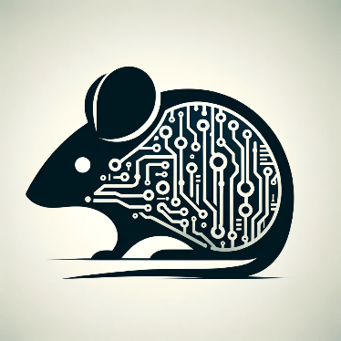
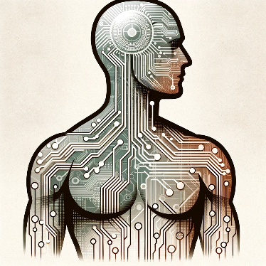
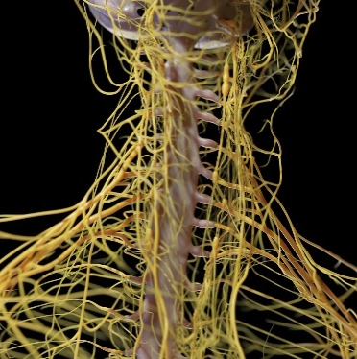


Division of Health AI Verticals
Preclinical AI
Autonomic Nervous System AI
Anatomical Data AI
Point-of-care AI
Operational AI
Develop algorithms that use non-invasive physiological data to diagnose disease presence & severity and predict treatment efficacy
Develop algorithms that use neural recordings from preclinical models to diagnose & predict disease states
Develop operational decision support tools to provide enterprise insights and assist in health system wide issues
Develop clinical decision support tools to diagnose and predict clinical outcomes and trajectories
Develop accurate in-silico models of human anatomy using multimodal imaging and AI

Slide 4
Prevent
Predict
Personalize
Deploy Researched AI – Research Deployed AI
Notes:
So I'm gonna talk about 3 use cases and models outlining three P’s I have in my title; prevent predict and personalize.

Slide 5
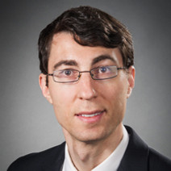
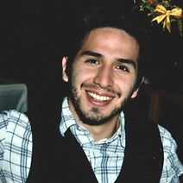
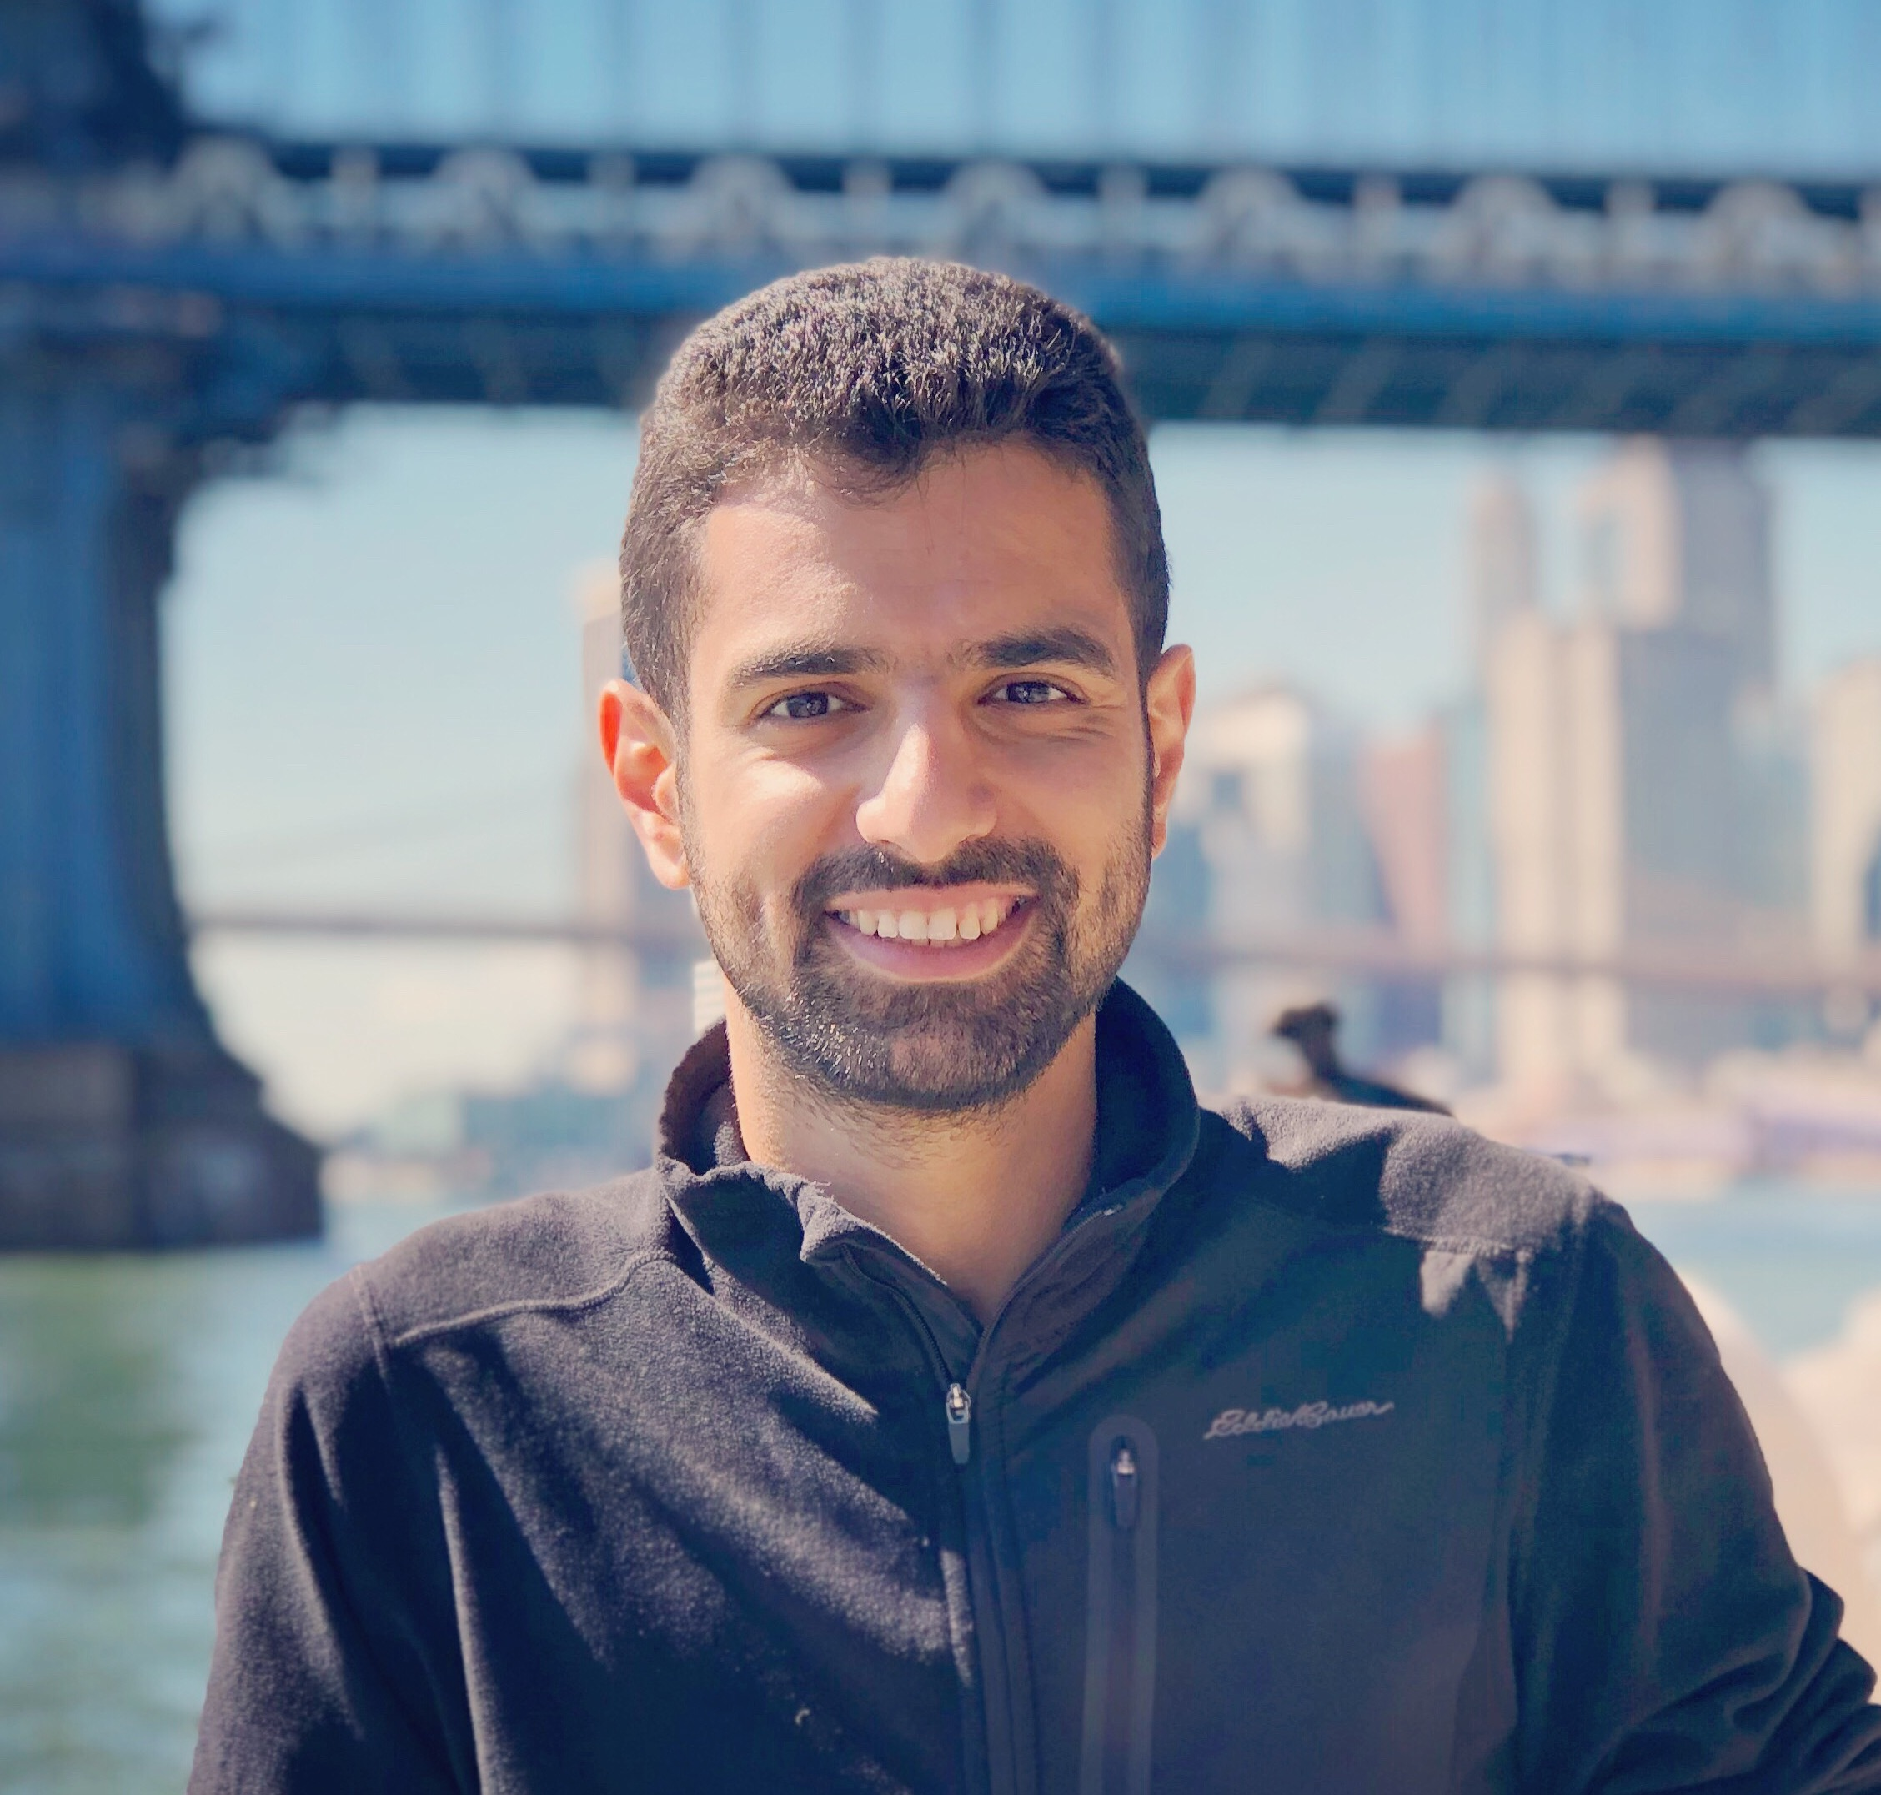
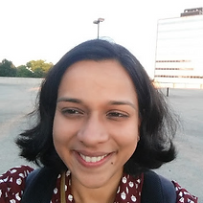
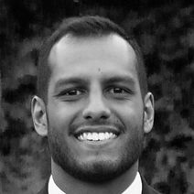
Prevent - Point-of-care AI
Develop clinical decision support tools to diagnose and predict clinical outcomes and trajectories
Todd Levy, MS
Senior Biomedical Engineer
Michael Scheid, PhD
Senior Biomedical Engineer
Hardik Patel D.O.
Postdoctoral Fellow
Nabil Ettehadi, PhD
Lead Data Engineer
Avantika Vardhan, PhD
Electrical Engineer
Shubham Debnath, PhD
Senior Research Scientist

Slide 6
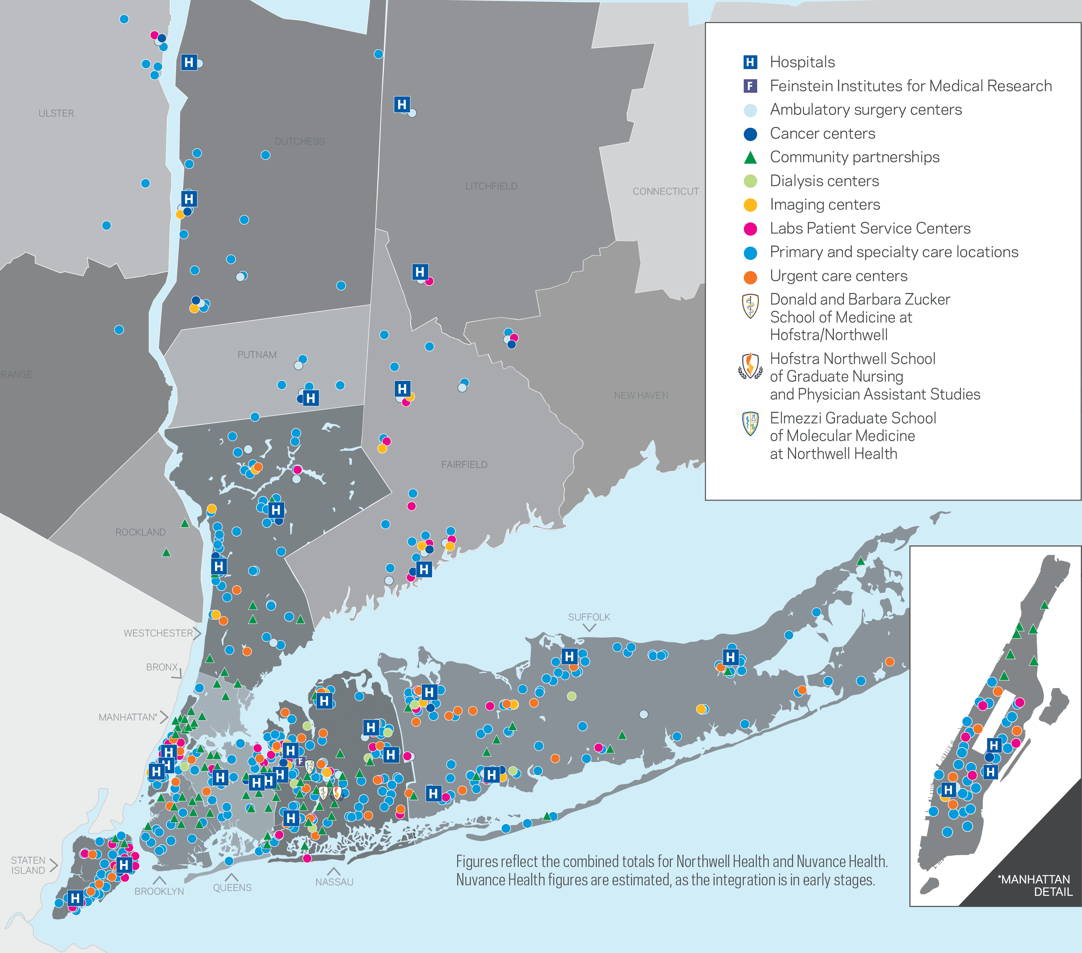
Northwell’s AI advantage
Largest health system in NY
28 Hospitals
>1000 Outpatient clinics
>2M patients treated annually, over 5.5M patient encounters
One of the most ethnically, culturally, genetically, socially and economically diverse population in the US (likely the world)

Slide 7
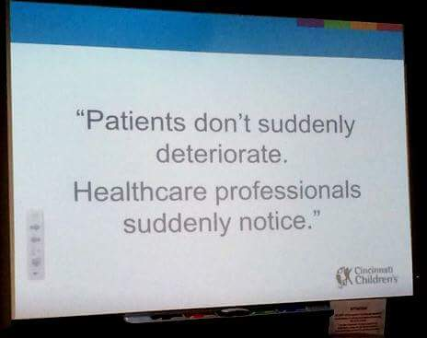

Prevent - AI for inhospital deterioration
ER setting: Nurses undertriage 17% and overtriage 12% of cases - Doctors undertriage 14% and overtriage 14% of cases*
5-15% of patients in medical-surgical wards deteriorate requiring elevation of care
Dr. Patrick Brady
Labs
Demographics
Vitals
Comorbidities
nso.com
Medical notes
Radiographs
*Ruttanaseeha et al. 2020
Notes:
Let's start with using AI to prevent in hospital deterioration. We know that when patients present to the ER, they are often under triaged or over triaged by both nurses and doctors meaning that many of them might end up in a medical/surgical unit, when they should have been admitted to a critical care unit. Because of that, depending on the hospital 5 to 15% of patients deteriorate, supposedly stable patients actually deteriorate during their hospitalization requiring elevation of care either a transfer to the ICU a rapid response team call intubation and some of them unfortunately die on the floor and I always think about this quote from doctor Patrick Brady that says that patients don't suddenly deteriorate we suddenly notice and that of course is not meant to blame our frontline cdoctors and nurses, because they are doing a tremendous job caring for patients, but identifying the subtle signs of deterioration early enough to prevent it, is a tall ask especially from people that are overworked and that have to look for these very subtle signs across many data and signals, between labs and vitals and images, taking into account demographics and comorbidities, looking at vast medical notes, and doing that for multiple patients at a time, this is an incredibly hard task which we believe can become easier with the help of AI.

Slide 8
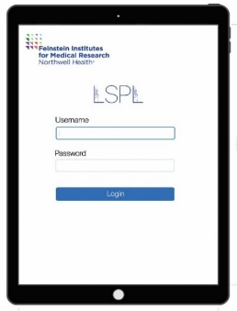
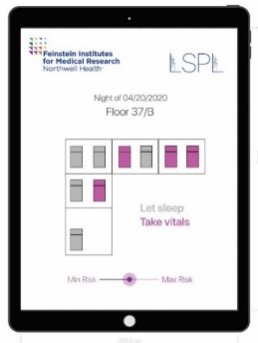
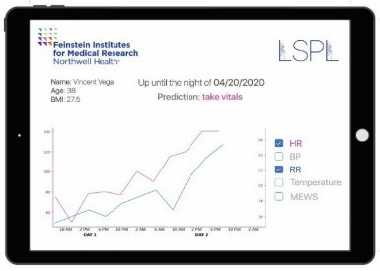
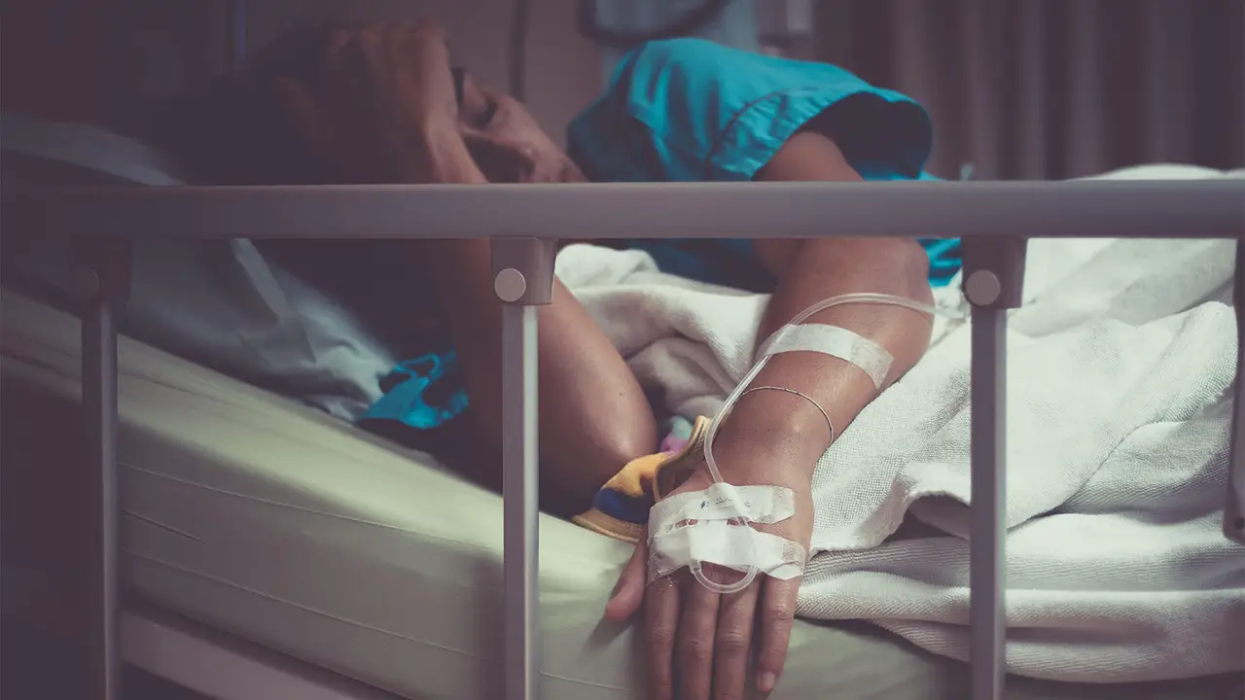
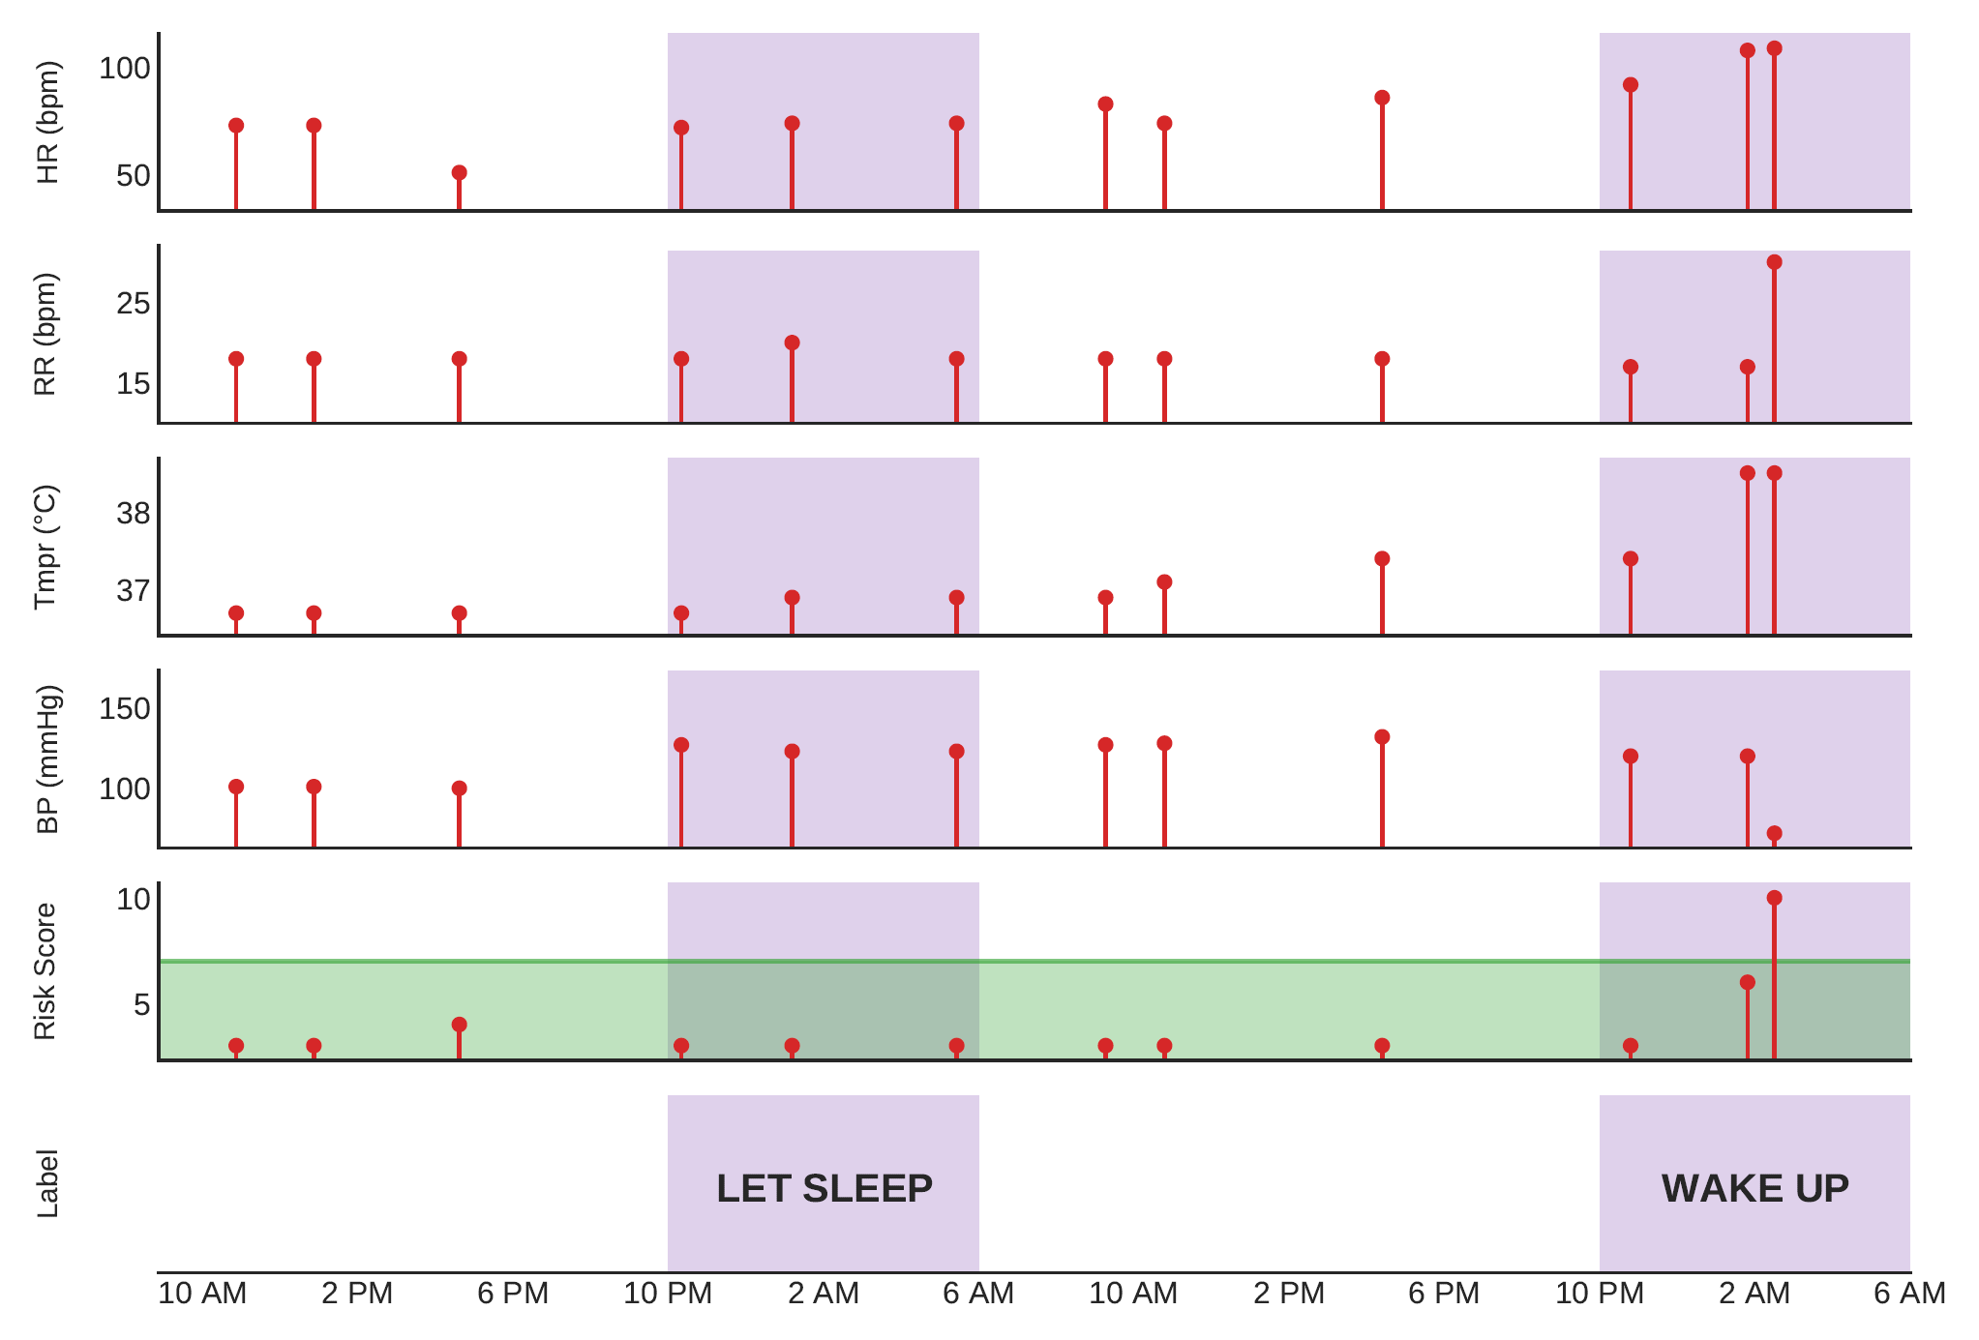
Step 1: “Stop the unnecessary”
Avoid >50% of overnight sleep interruptions
“Let Sleeping Patients Lie”
Toth et al. 2020 npj Digital Medicine
Notes:
To solve this problem, we took a 3-step approach:
Step 1- Stop the unnecessary: We looked at the main complaints of our patients. #1 on that list? They don’t sleep well in the hospital. Every patient is woken up at 3 or 4am, to take their vitals, even if they were perfectly stable. We developed an AI tool to identify these perfectly stable patients and avoid these unnecessary sleep interruptions with safety, reducing overnight wake-ups by 50%, asking our nurses to do less, not more. Patients that sleep better, leave the hospital earlier, have better outcomes and give better ratings.

Slide 9
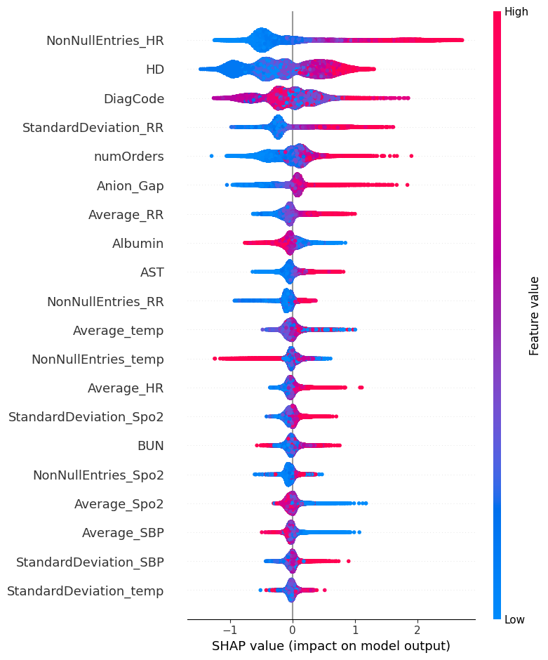
Step 2: “Prioritize those who need it”
Trained on >1.5M hospitalizations
Predicts combined outcomes: deaths, ICU transfers, RRT calls
Uses 18 EHR features for 7-day risk probability
Achieves high accuracy (>90%), outperforms Epic Deterioration Model by 25% - currently “silently” running in 7 hospitals
Performs consistently across demographics and hospitals
Plan to go live with all Epic Northwell hospitals this summer
Hansen et al. (in prep)
Notes:
Step 2 is to prioritize patients that really need increased attention. We developed a model that can rank patients using the first labs, demographics and vitals measured even from the ED, to predict a combined outcome of inhospital deaths, unplanned ICU transfers, RRT calls. The model is very accurate, outperforming the Epic Deterioration Index, the most popular model used in multiple health systems around the country, it has consistent performance across race, age, sex, ethnicity, insurance type patient groups, as well as across all Northwell hospitals and it’s live “silently”, meaning we’re testing it in the background to make sure it works great across 7 of our hospitals and planning to go live next summer.

Slide 10
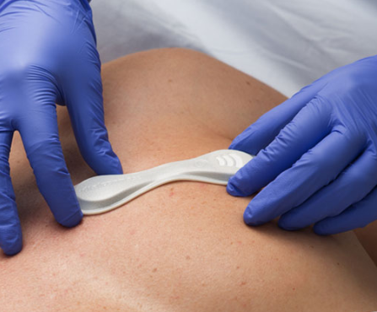
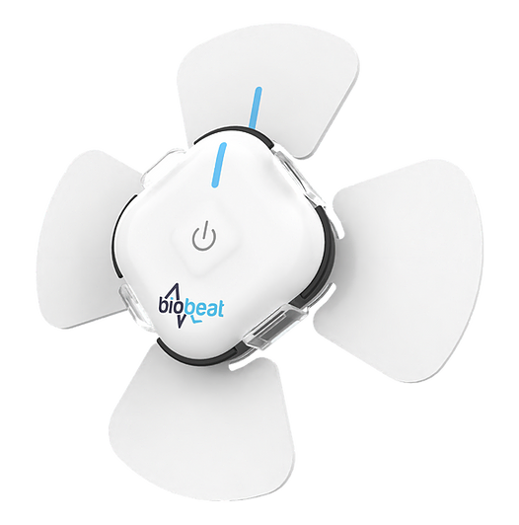
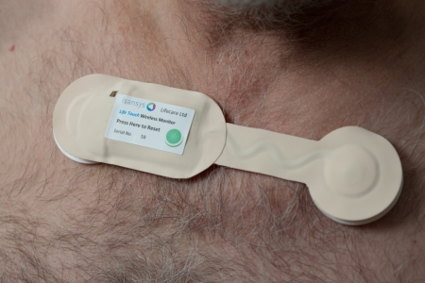
Step 3: “Monitor and predict”
VitalConnect VitalPatch
Biobeat Chest Monitor
Isansys Lifetemp
3 different devices
>8k patients, >18k days of data collected already
Goal of 10k, >25k days patients in 1 year
4-year, $3.2M grant
Notes:
Step 3 is to use novel clinical wearables to further monitor our patients every second of their hospitalization and predict deteriorations using the data from the wearables. We’re doing this as part of a NIH grant that we received, and we’ve tested 3 different clinical wearables, gathering data from >8k patients and >18k patient days, and our goal is to build the largest clinical wearable database in the country by the end of 2026.

Slide 11
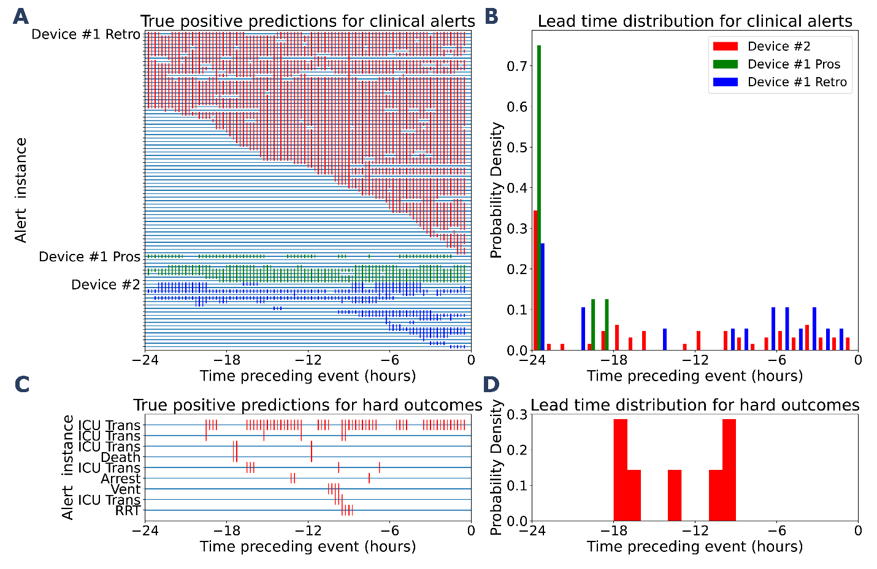
Deep Learning + wearables to predict alerts
Trained on >1.3k clinical patches
>94% sensitivity
Algorithm agnostic to the wearable
Average lead time for clinical alerts and outcomes: 17h in advance
Scheid et al. 2025, Nature Comms
Notes:
Using these wearable data, we showed in a recent publication that we can predict very accurately, with >94% sensitivity, and 17h in advance, an impeding deterioration, triggering specific clinical actions to stave off the deterioration.

Slide 12
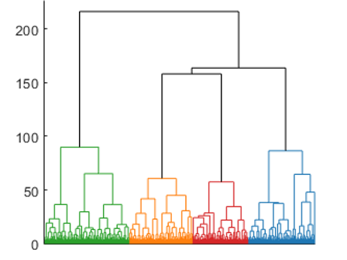
Answering Why
Unsupervised learning
Major clinical phenotypes should cluster patients to unique groups
Initial application on COVID-19 patients presenting to the ED
Applicable on optimization of clinical trial recruitment
Mild phenotype, elevated immune cell counts
Low Lung inflammation
High Lung inflammation
Poor kidney function
Ho et al. 2024, IJMI

Slide 13
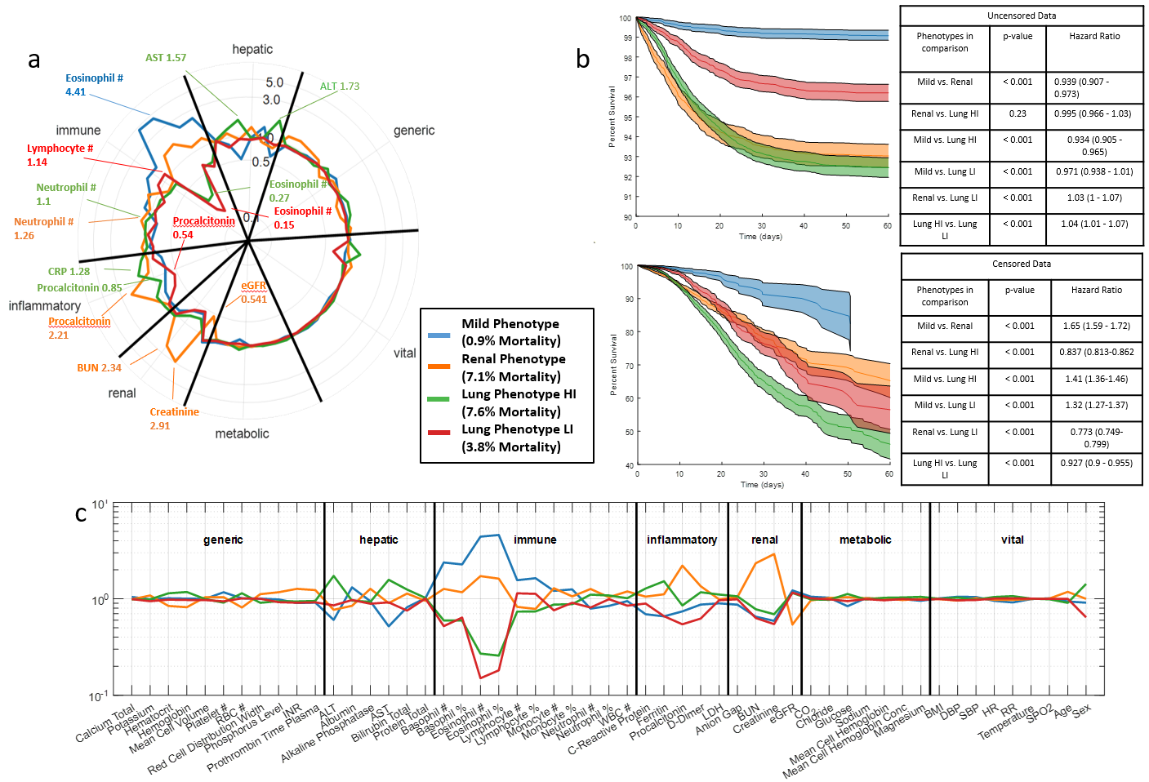
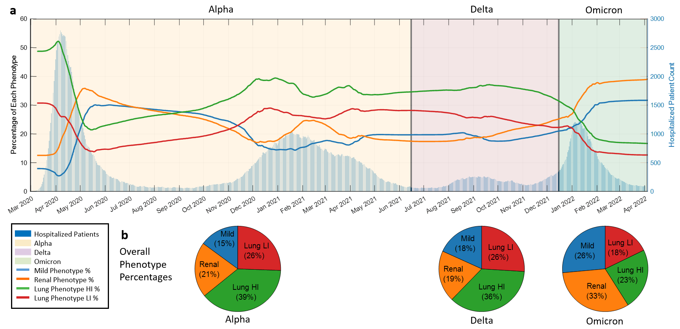
Answering Why
Ho et al. 2024, IJMI

Slide 14
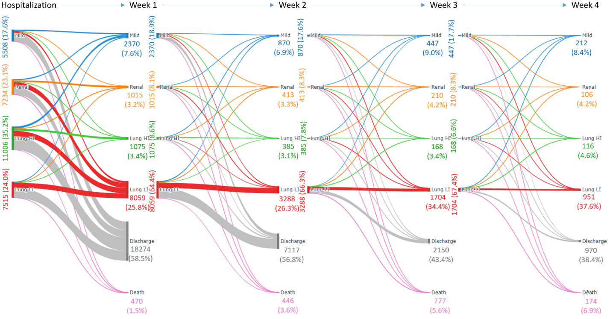
Answering Why and when
Ho et al. 2024, IJMI

Slide 15
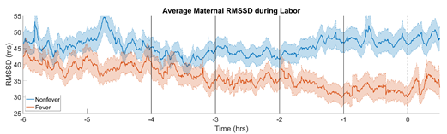
Monitoring during labor
Neonatal early onset sepsis
Major cause of morbidity/mortality
Maternal fever during labor is the strongest predictor
Continuous vital data from 336 women during labor, including HRV
Model predicts fever 2-3h before onset
HRV one of the most important predictors
Barry Weinberger, Rob Koppel
Koppel et al. 2022, J Clin Mon
Debnath et al. 2023, Digital Health

Slide 16
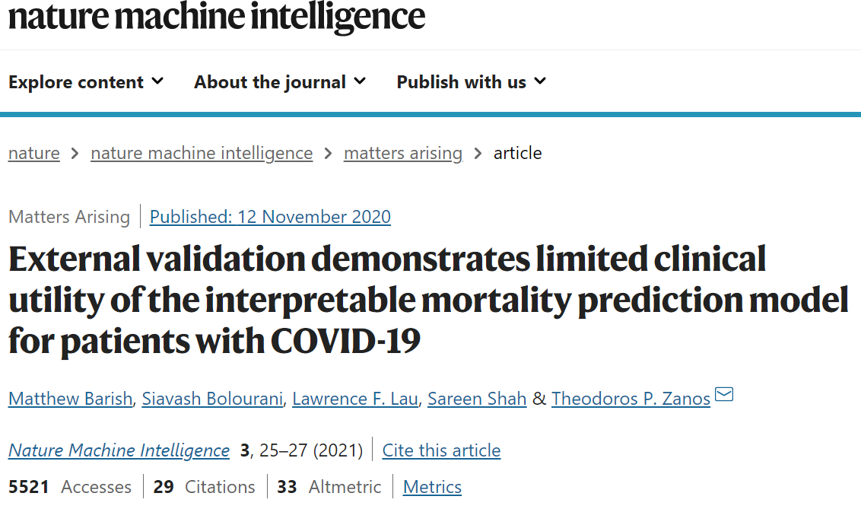
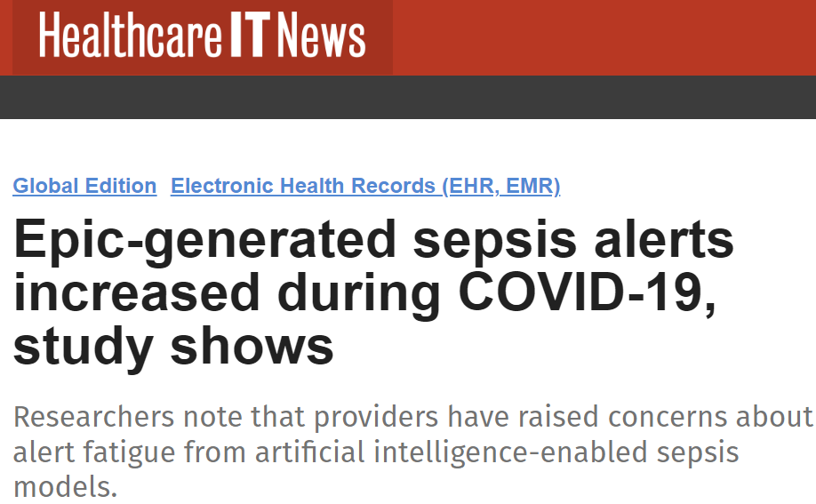
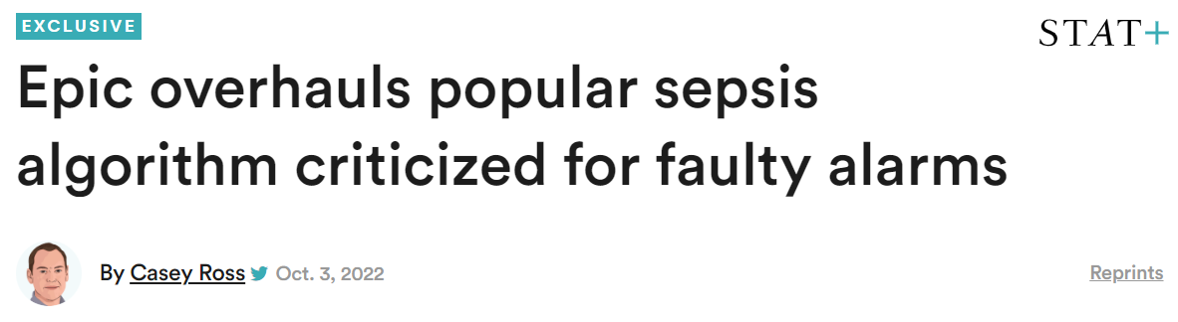
AI Performance Drifts
Clinical prognostic models can experience performance drifts
Changes in patient case mix and numbers, new treatments, new variants (viral diseases)
Emerging/new diseases/comorbidities can affect predictions of outcomes
Especially true when
Models are developed in a specific geography and time and used elsewhere/subsequently
Try to predict outcomes of dynamic diseases/ conditions
Models get updated occasionally
EuroSCORE was updated 12 years after 1st version
QRISK is updated every year

Slide 17
Research Deployed AI - Epic and CDS
Systematic review and meta-analysis
22 validation studies
32 sites
3.2M patients
5 models
Sepsis (11 sites): AUROC - 0.65 (from 0.8)
Unplanned Readmission (7 sites): AUROC – 0.7 (0.74)
End-of-Life (3 sites): AUROC – 0.76 (0.9)
No-Show (2 sites): AUROC – 0.62 (0.77)
Deterioration Index (9 sites): AUROC – 0.79 (0.81)
Northwell Deterioration Model: AUROC – 0.9
Epic Sepsis Model
Epic Deterioration Index
Patel et al. (J of Gen Internal Med, under review)

Slide 18
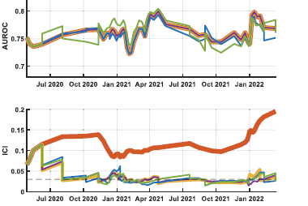
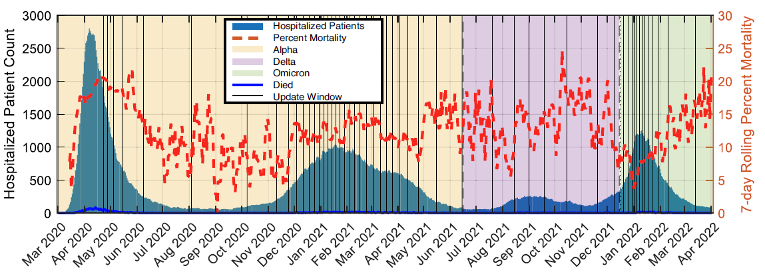
Self-monitoring Auto-updating models
Levy et al. 2022, Nature Comms

Slide 19
Predict - Operational AI
Develop operational decision support tools to provide enterprise insights and assist in health system wide issues
Todd Levy, MS
Senior Biomedical Engineer
Nabil Ettehadi, PhD
Lead Data Engineer

Slide 20

Challenges in nursing – the long-lasting consequences of the pandemic
2023 survey in >18k RNs (AMN Healthcare)
Career satisfaction: 71% (drop from 80-85% last decade)
30% likely to leave nursing (up 7 points from 2021)
4/5 experience stress (up 16 points from 2021), worry job is affecting their health up 19 points, often feeling emotionally drained up 15 points
94% agree on severe/moderate shortages
80% expect the shortage to get worse
Notes:
Career satisfaction has been at 80-85% for a decade; in 2023, it dropped to 71%. Likelihood of encouraging others to become a nurse is down 14 points from 2021.
Only 15% of nurses employed in hospitals say they will “continue working as I am” in one year. 36% of hospital nurses say they will continue working as nurses but seek a new place of employment.
30% of nurses say they are likely to leave their career due to the pandemic, up 7 points since 2021.
Four of five nurses say they experience a great deal or a lot of stress, up 16 points from 2021. Worry that their job is affecting their health is up 19 points. Often feeling emotionally drained rose 15 points.
94% of respondents agree there is a severe or moderate shortage of nurses in their area, with half of nurses saying the shortage is severe.
80% of nurses expect the shortage to get much worse or somewhat worse in the next five years, with half of nurses saying the shortage will get much worse.

Slide 21
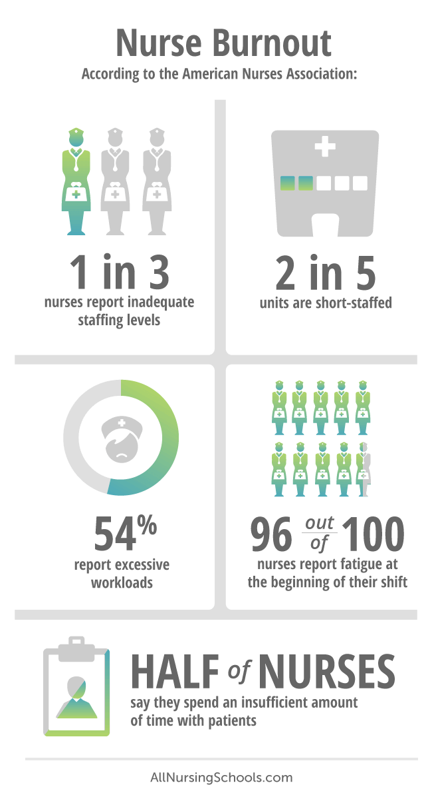
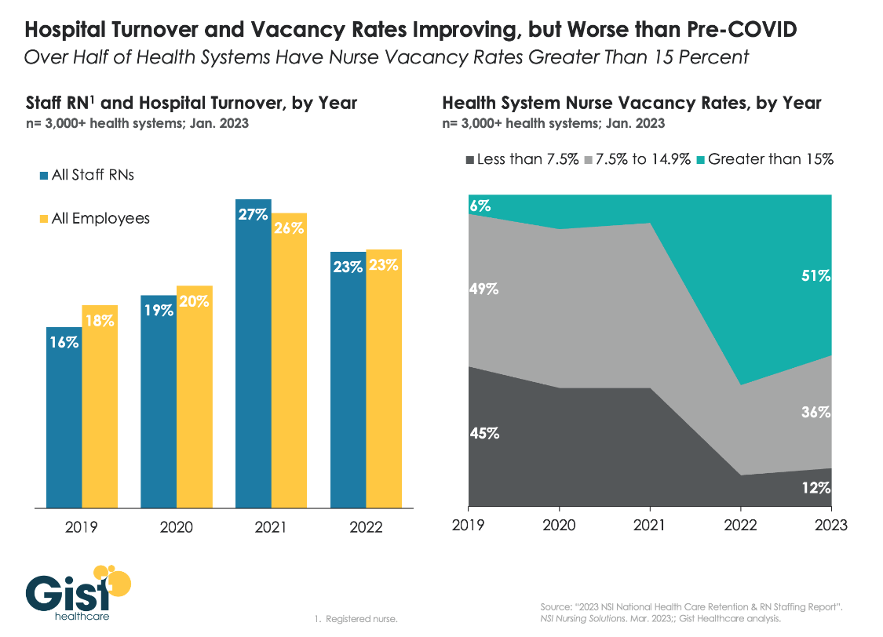
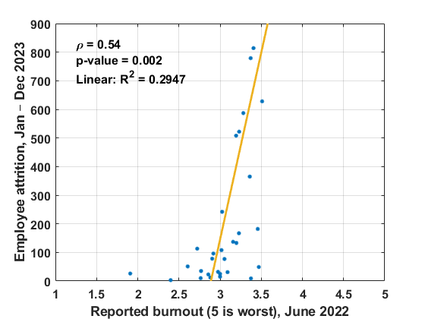
The vicious cycle of nurse burnout and turnover
Notes:
Nurse burnout is a global problem, exacerbated by the COVID pandemic, with devastating percentages of nurses reporting being short staffed, working too much, not spending enough time with their patients and feeling burned out. That feeling of burnout of course causes many of them to quit their jobs and leave nursing altogether, making the problem even worse.

Slide 22
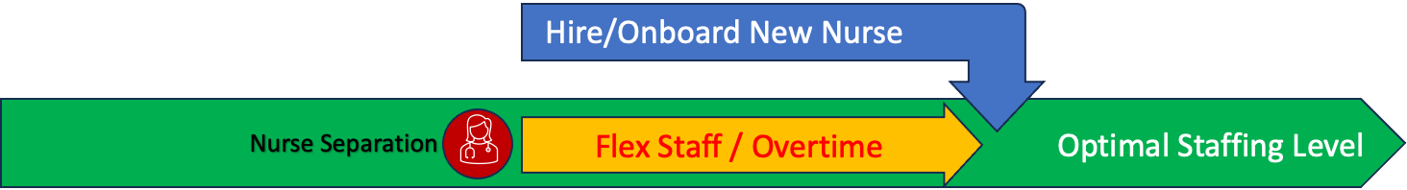
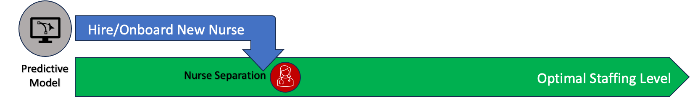
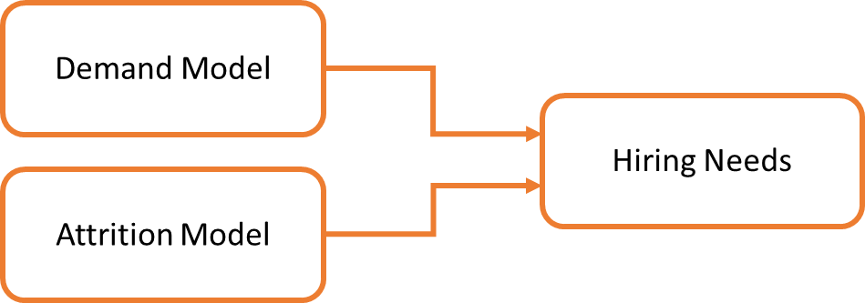

Preemptive Nurse Hiring Forecasting
Nurse Separation triggers hiring process and requires Flex and Overtime to maintain staffing levels
Current:
Future:
Predictive Model starts hiring process before Nurse Separation, reducing reliance on Flex and Overtime
Notes:
Every time a nurse leaves, health systems usually react by opening up a new position and trying to recruit for it. That process can take many months, from reviewing applicants, extending offer letters, onboarding them and training them so that they're ready to perform their duties. During these months patients don't stop showing up in our hospitals so the need is still there and it’s covered by either increasing overtime for existing nurses or hiring flex staff, temporary nurses. The issue with increasing overtime is obvious - we're once again overworking our nurses. Flex staff on the other hand is very expensive and full time nurses usually don't like to train temporary nurses that show up only for a limited amount of time. Instead, what we propose is a preemptive strategy to nurse hiring, predicting how many nurses we should hire now, before they leave, to counterbalance both those that are going to leave, as well as increases in the number of patients we see, minimizing our reliance on flex staff and not overburdening our existing nurses.

Slide 23
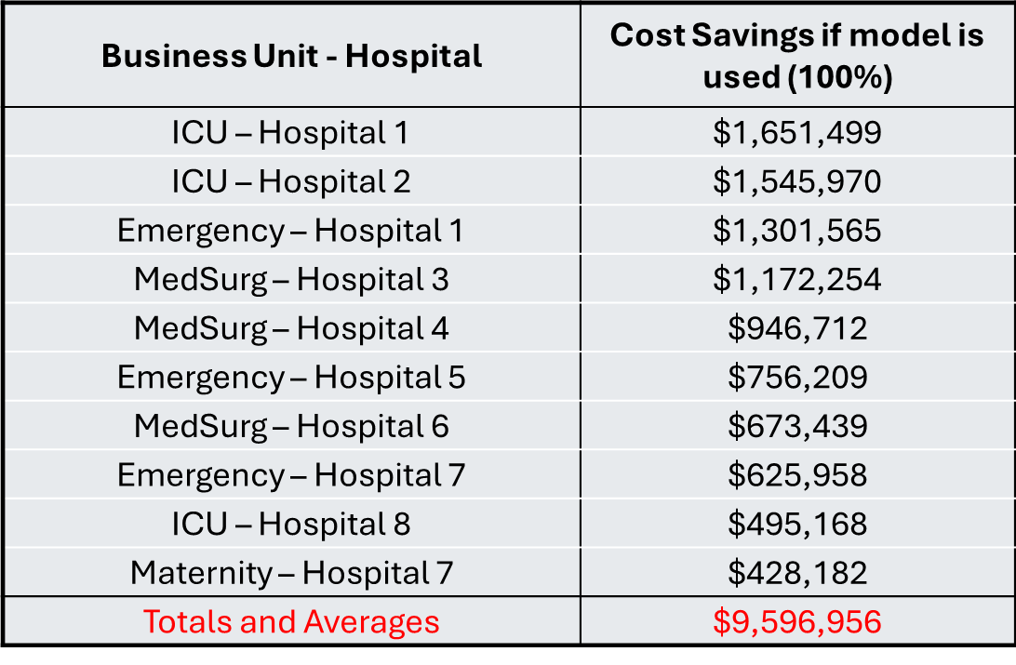
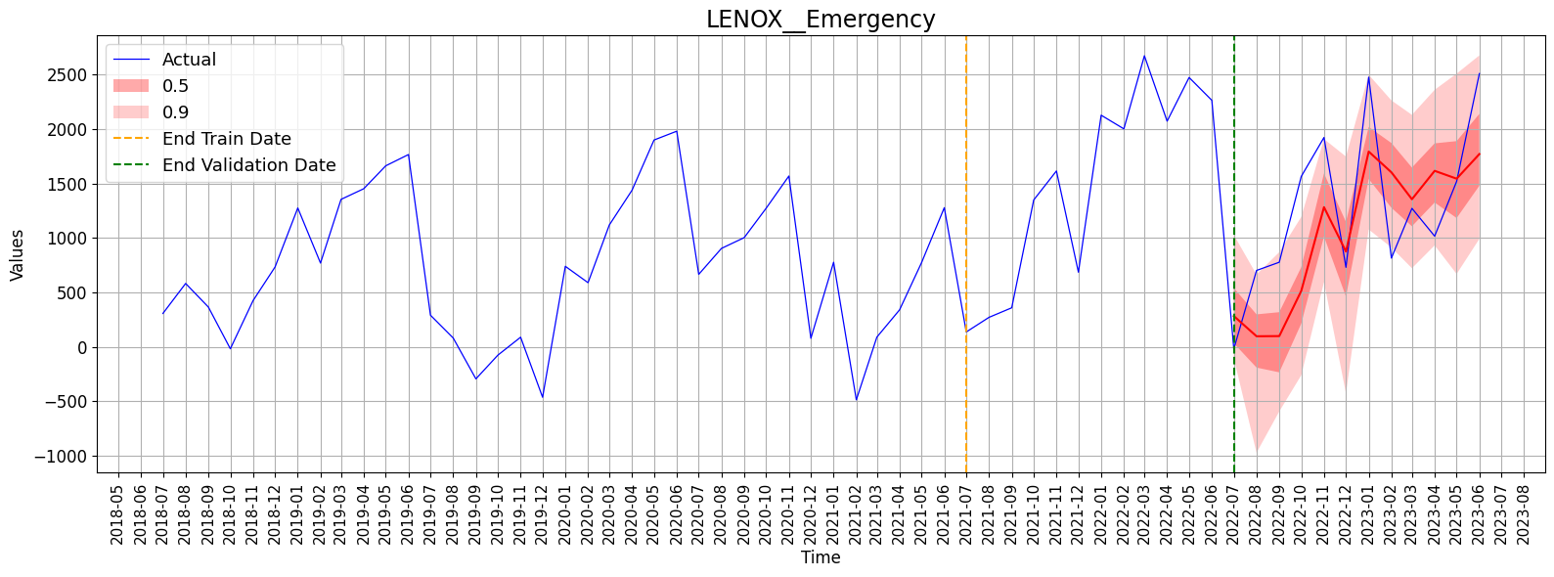
Nurse demand & attrition forecasting
DeepAR models using
Historical demand & attrition
Demographics (age, marital status etc.)
Role related (tenure, union, level, etc.)
Job related (overtime/sick hours, hospital distance from home, etc.)
Forecasts of demand + attrition up to 12 months ahead
Hiring suggestions based on both
Estimated Cost Savings in 10 (out of >400) units
*Estimates based on $120/h for Flex (blended shift, contract & M&I), $75/h for Non-Flex (avg gross including OT), for the period March 2022 - March 2023
Ettehadi et al. 2025, EMBC
Notes:
To achieve that, we developed another AI model that was retrofitted from an algorithm that Amazon uses to predict sales of their merchandise. This state of the art model uses historical trends of both nursing demand and attrition, demographics, job and role related data such as tenure of nurses and hospital distance from home, to try to predict both how many nurses we are likely to loose for each individual unit at all our hospitals, over the next 12 months, as well as how many nurses we will actually need during the same amount of time. Using this model, we estimated that in only 10 out of the more than 400 units we have in our health system, we could be saving close to $10 million a year - And these cost savings are calculated only based on what we could save from reducing our flex staff utilization, not counting overtime reduction and of course not counting all the benefits of properly staffed units and hospitals.

Slide 24
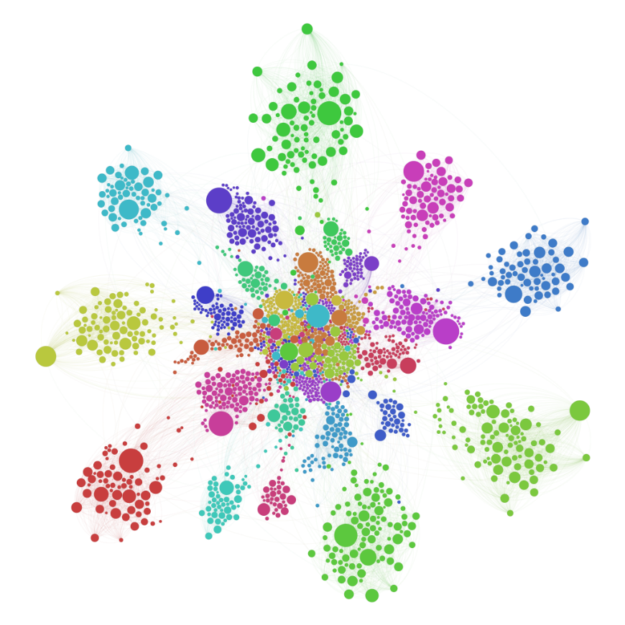
Phenotyping Attrition
Unsupervised clustering to identify “separation phenotypes”
Combine well-being survey data with HR data
Identify distinct clusters of all nurse separations
Examine their profile – answer the Why?
Identify modifiable factors
Design intervention strategies

Slide 25

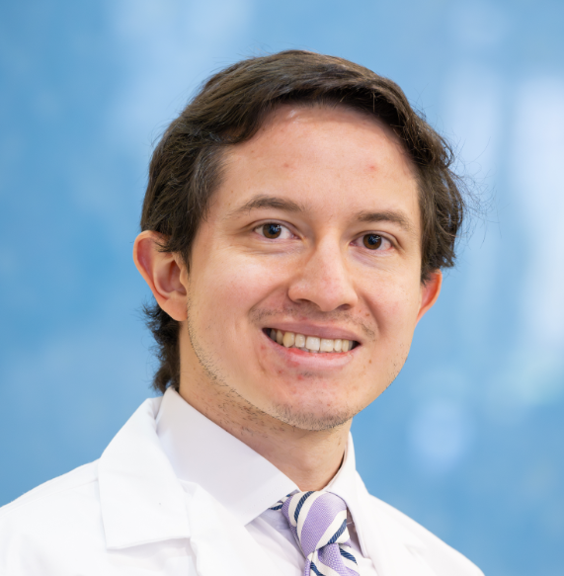
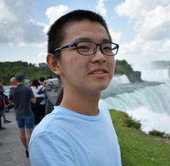

Personalize – AI in Bioelectronic Medicine
Develop algorithms that use neural recordings from preclinical models to diagnose & predict disease states
Develop accurate in-silico models of human anatomy using multimodal imaging and AI
Develop algorithms that use non-invasive physiological data to diagnose disease presence & severity and predict treatment efficacy
Shubham Debnath, PhD
Senior Research Scientist
Todd Levy, MS
Senior Biomedical Engineer
Alejandro Quintero Villegas, MD
Elmezzi Scholar
Lucas Cang
Research Assistant
Fylaktis Fylaktou
PhD

Slide 26
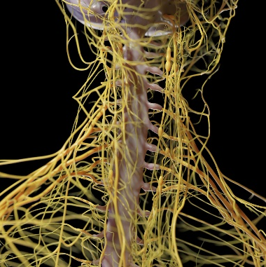
Anatomical Data AI
Develop accurate in-silico models of human anatomy using multimodal imaging and AI
Todd Levy, MS
Senior Biomedical Engineer
Avantika Vardhan, PhD
Electrical Engineer
Lucas Cang
Research Assistant

Slide 27
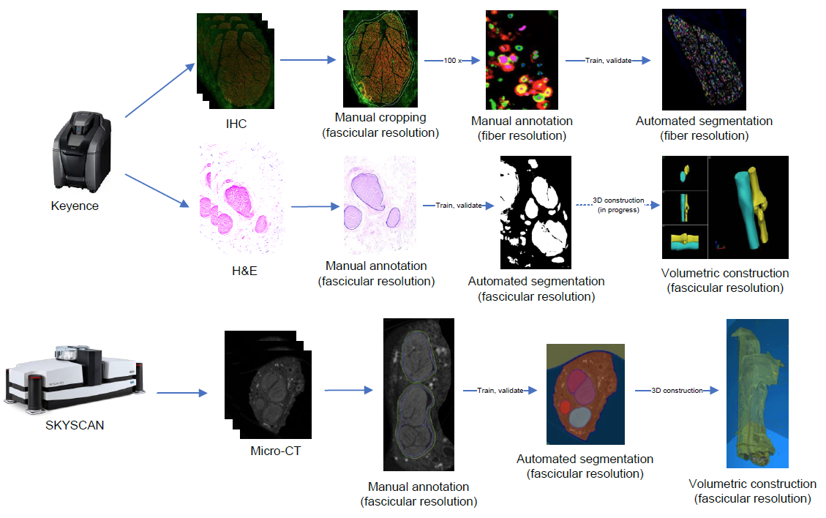
REVA 60 Nerves (30 L, 30 R)
>3M microCT images
>4000 IHC/H&E images
~200 TBs of data

Slide 28
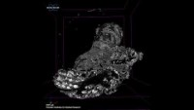
Personalize – AI for Vagus anatomy
Vagal fibers travel inside fascicles form branches to innervate organs and regulate/monitor organ functions (and the GI track!)
Existing Vagus Nerve Stimulation (VNS) therapies stimulate the nerve non-selectively
Reduced efficacy
Side-effects from non-targeted organs/systems
Spatial arrangement of fascicles/fibers in the human vagal trunk is unknown
Essential to build selective VNS therapies
$6.7M NIH Grant (2023-25) with TNP Lab
>4M images (~200TB of data)
Jayaprakash et al. 2022, Brain Stim
Notes:
And finally let me show you how we use AI to personalize bioelectronic medicine. You all know that Feinstein is the scientific birthplace and home of bioelectronic medicine and our researchers are constantly advancing the field. One important need to develop better, more personalized bioelectronic medicine devices is to understand in detail the anatomy of the vagus nerve, the main neural structure that we stimulate. We know that the vagus nerve is a very complicated structure, with thousands of fibers grouped into bundles called fascicles that eventually form branches that separate from the nerve and go and innervate different organs. Current VNS devices stimulate the nerve as a whole. all these fascicles and all these thousands of fibers non selectively and that could reduce the efficacy of these treatments, but also introduced unwanted side effects. Up till now, no one knows exactly how these fibers and fascicles and branches are arranged spatially in the human Vagus and that knowledge is essential to build the next generation of selective VNS devices. This is why the NIH is currently funding our effort, which is a collaboration with my brother Stavros Zanos, where we're answering exactly that question for the very first time using more than 4 million microscopy and micro CT images to describe that anatomy down to the level of an individual fiber. The data that needs to be processed as part of this effort is really big - more than 200 terabytes, to give you a perspective using your cell phone you would need to take more than 250 million photos to reach this number, which since I have a 2 year old I have personally reached in his first six months. Only advanced AI algorithms can make sense of all this data.

Slide 29



Deep Learning for vagus digital twin
3D nn U-Net segmentation
Notes:
So this is what we're developing, using deep learning we are creating the most detailed human vagus digital twin in existence, reconstructing in all its detail and glory the nerve and mapping out, much like the NY subway, a metro map of the different lines, stops and organ terminals of the vagus, so we know when and which train to take, and where to get off to achieve the most optimal, personalized bioelectronic therapy.

Slide 30



Anatomical variability
What are the optimal stimulation parameters?
Closed-loop but for what?

Slide 31

Autonomic Nervous System AI
Develop algorithms that use non-invasive physiological data to diagnose disease presence & severity and predict treatment efficacy
Shubham Debnath, PhD
Senior Research Scientist
Fylaktis Fylaktou
PhD Student
Alejandro Quintero Villegas, MD
Elmezzi Scholar

Slide 32

Prediction of treatment efficacy for VNS
Vagus Nerve Stimulation for Epilepsy patients
Success: 65% for reducing seizures to half
Quintero-Villegas et al., Bioelec Med 2025

Slide 33

PTSD
1-4% of general population, up to 15-20% in conflict zones
Increased risk of suicide, disability, unemployment, comorbidities
Underdiagnosis: Outpatient setting: 20.5% of patients met criteria for PTSD, but only 2.4% had received a PTSD diagnosis (Da Silva et al.)
Underdiagnosis influenced by stigma, symptom avoidance, limited healthcare access
Limited treatment options – Vagus Nerve Stimulation as a viable alternative
Current tVNS trials for PTSD have not yet shown any significant effects on clinical outcomes – Why?

Slide 34

Trauma’s physiological signature
ML to predict PTSD presence (CAPS-5 label) & severity ( PCL-5)
30 PTSD Patients, 49 Healthy
152 sessions used as labeled data (95 healthy, 57 PTSD)
80-20 Train/test splits
Participants (Sessions) | Total | Train (80%) | Test (20%)
All | 152 | 121 | 31
PTSD | 57 | 45 | 12
Healthy | 95 | 76 | 19
Fylaktou et al. (under review)

Slide 35

ANS Challenges
Debnath et al. (2019)

Slide 36


Feature extraction
Fylaktou et al. (under review)

Slide 37

Model pipeline
Fylaktou et al. (under review)

Slide 38

Disease Presence Model performance
Fylaktou et al. (under review)

Slide 39

Disease Severity Model Performance
Fylaktou et al. (under review)

Slide 40

Parsimonious models
Fylaktou et al. (under review)

Slide 41
Preclinical AI
Develop algorithms that use neural recordings from preclinical models to diagnose & predict disease states
Shubham Debnath, PhD
Senior Research Scientist
Todd Levy, PhD
Senior Biomedical Engineer

Slide 42




Decoding Vagus Nerve Signals related to Inflammation
Zanos et al. 2018, PNAS
Zanos et al. 2019, CSH Persp Med
Levy et al. 2020, J Neurosci Meth

Slide 43



Decoding Vagus Nerve Signals related to metabolic states
Levy et al. 2020, J Neurosci Meth
Masi et al. 2019, Bioelec Med

Slide 44



Vagus Nerve Signals in a chronic implant mouse model
Debnath et al. IJNS 2025

Slide 45


Chronic Vagus Nerve Recordings
IL-1β injection on day 137 after implant
Predicting disease severity based on VN recordings
Rheumatoid Arthritis (CIA, CAIA models)
Predicting treatment efficacy based on baseline VN recordings
VN Stimulation
Debnath et al. IJNS 2025

Slide 46

Lessons Learned
AI as a tool
Point-of-care
Operations
Anatomy / Device optimization
From the health system standpoint
Not everything needs to (should) be solved with AI
Find and foster clinical AI champions
Develop system-wide validation/deployment pipelines
“Deploy researched AI, research deployed AI”
For the field
Not everything needs to be genAI
“There’s always money in the banana stand”

Slide 47










Thank you!
tzanos@northwell.edu

